Slide 1
I have Rheumatoid Arthritis
How can I do things differently to relieve pain?

Slide 2
Sliding Items Off a Shelf
Notes:
For shelved items, place the palm of one hand against the side of the item to be picked up. Place fingers of the other hand under the shelf with your palm facing upward. Slide the items toward the edge of the shelf onto your palm.

Slide 3
Holding Heavier Jars, Cans, and Pans
Notes:
Grasp it between the palms of both hands and use the movement of your arms rather than your wrists. Lift items to the nearest countertop and slide it along the counter to desired location.

Slide 4
Opening a Jar
Notes:
To open a jar, put most of the pressure on the palm of your hand rather than your knuckles. Prevent twisting and torsion-type movements. An adaptive jar opener is also available to purchase.

Slide 5
Stirring
Notes:
When stirring, hold the spoon as in the picture to avoid excess stress on the finger joints.

Slide 6
Holding a Kitchen Utensil
Notes:
Add padding or purchase built-up kitchen utensils for easier grip.

Slide 7
Picking Up a Plate
Notes:
Keep your wrists in a neutral position with fingers extended and thumbs pointed toward the ceiling.

Slide 8
Opening Ring Top Cans
Notes:
Place a knife through the ring with the handle of the knife directly under the opening. Using the palm of your hand, push down on the handle of the knife until the ring pops open.

Slide 9
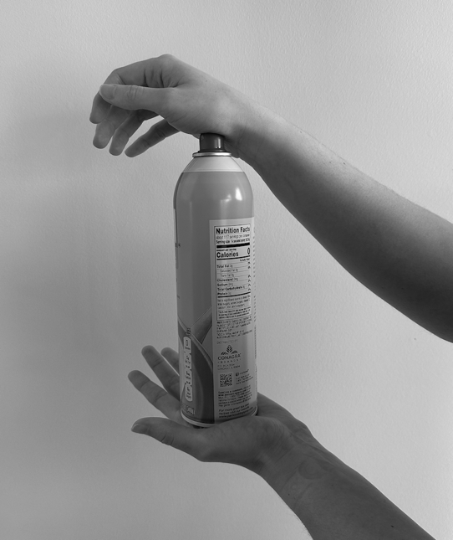
Spray-Top Cans
Notes:
Use both hands to spray an aerosol can. Hold the can in the palm of one hand. With the wrist of the other hand extended and the fingers relaxed, press down on the nozzle, using the heel of your hand. Do not use index finger to depress the nozzle.

Slide 10
Picking Up and Holding a Mug
Notes:
Slide adaptive silicone cup handles onto wide mouth mugs/cups for easier grip.

Slide 11
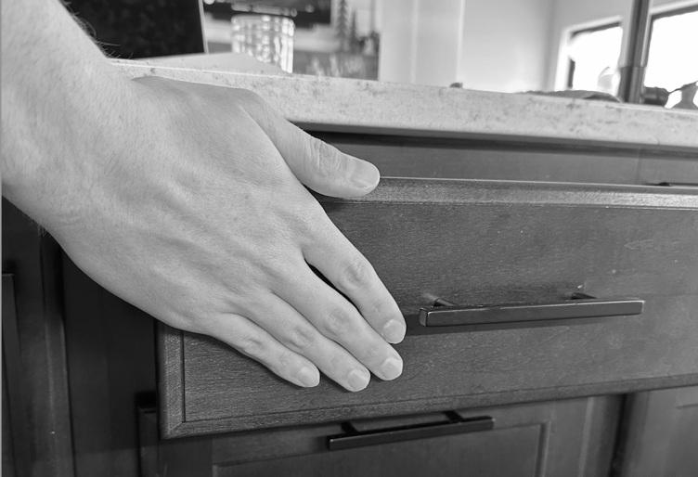
Close Drawers with Palm of Hand
Notes:
To close drawers, place your palms flat against the drawer and close the drawer using shoulder motion while keeping your wrist stabilized.

Slide 12
Turning On/Off Winged Faucets
Notes:
Always keep your wrist extended. Use the palm of your hand to turn it off, and back of your hand to turn it on. Try to use the movement of your arm, not your wrist, to turn the faucets on and off.

Slide 13
Holding a Purse
Notes:
Use larger or more stable joints or muscles to carry a handbag. This will prevent added stress of the finger joints.

Slide 14
Carrying a Briefcase
Notes:
To carry a briefcase, place the case under your arm so that the case is resting on your forearm. Hold briefcase by pressing your arm against your body, periodically switching from one side of the body to the other side.

Slide 15
Getting Up From a Chair
Notes:
To get up from a chair do not bend your knuckles under your hand, but instead use the palm of your hand and your leg muscles to rise from the chair.

Slide 16
Light-Switch
Notes:
Push buttons are the easiest switches to use. For both push button and standard switches, place the palm of your hand on the switch, keep your wrist in neutral position, fingers extended and use the movement of your arm to operate the switch.

Slide 17
Brushing Teeth
Notes:
Grasp the handle of the toothbrush between your thumb and the palm of your hand. To apply toothpaste to the brush, place tube on counter or sink and use the palm of your hand to squeeze the toothpaste.

Slide 18
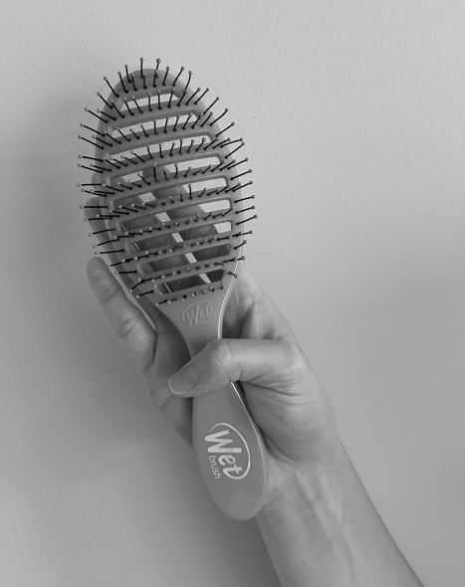
Brushing Hair
Notes:
Grasp the handle of the hairbrush between your thumb and the palm of your hand.

Slide 19
Using a Razor
Notes:
To use a razor, rest it in the slightly cupped palm of your hand with the razor head parallel to the middle finger. Keep your wrist in a slightly extended position and use the motion of your arm to reach all areas.

Slide 20
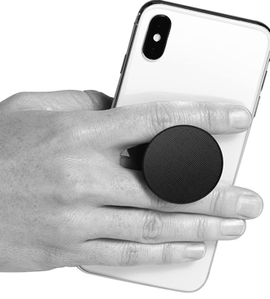
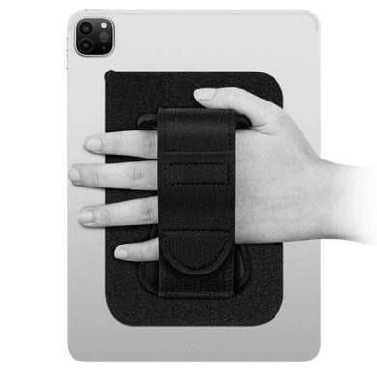
Holding a Phone/Tablet
Notes:
Use pop sockets, standing holders, or Velcro straps to assist with holding devices such

Slide 21
Holding a Book
Notes:
Instead of holding open books or magazines with one hand – use a book stand or holder to bring the book to eye level and use a clip to avoid prolonged gripping.

Slide 22
UnBuckle Me
Notes:
An adaptive device for parents, grandparents, babysitters, etc. used to assist in unbuckling car seats to relieve force from thumbs.

