Slide 1
Hand Care Tips for arthritis
Notes:
**Re-record this slide

Slide 2
Introduction
Your hands are constantly on the go
Everyday activities can damage your hands over time
Preparing a meal
Carrying grocery bags
Using a computer/Typing
Woodworking
Joint protection techniques can help reduce pain, stress, and inflammation of your joints.
There are many easy and inexpensive ways to protect your hands.
Notes:
Your hands are constantly on the go. Everyday activities, such as preparing a meal, woodworking, carrying grocery bags or using your computer can damage your hands over time. Joint protection techniques can help reduce pain, stress and inflammation of your joints. These techniques can also help prevent further deformities and increase your independence in daily activities. There are many easy and inexpensive ways to protect your hands. The following slides include a few tips to keep your hands healthy:

Slide 3
Give your hands a break
If you have pain during an activity, stop the activity.
Protect the small joints of your hands.
Remember to stretch and take rest breaks every 15 minutes during repetitive or prolonged activities.
Figure out which activities aggravate your symptoms and avoid or modify them.
Notes:
If you have pain during an activity, stop the activity. Pain is one of the best ways your body has to let you know that you are causing tissue damage, so listen to and respect your pain.
Protect the small joints of your hands and avoid carrying several plastic grocery bags at once to save time. Use paper bags, carry them one at a time and hold them at the bottom instead of using the handles.
Remember to stretch and take rest breaks every 15 minutes during repetitive or prolonged activities such as needlework, painting, sewing, knitting, hammering or filing.
Figure out which activities aggravate your symptoms and avoid or modify them; don’t be afraid to ask others for help.

Slide 4
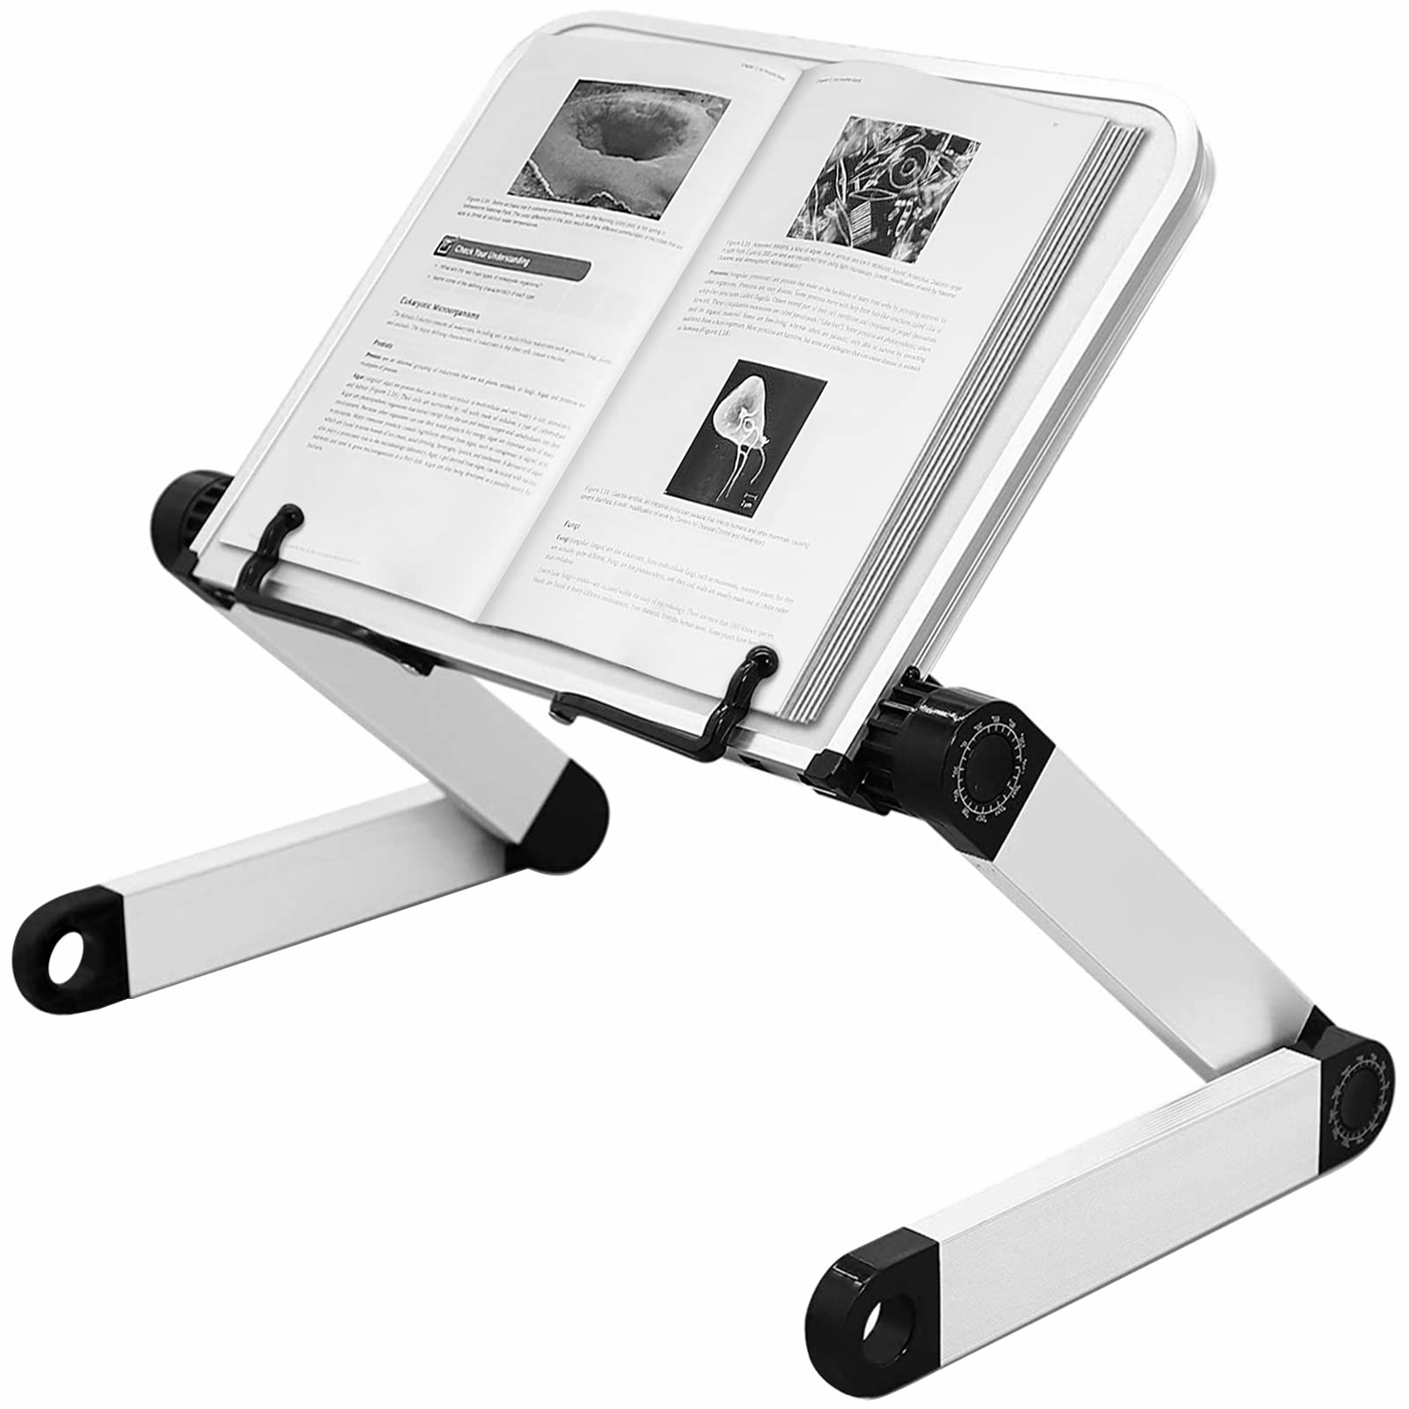
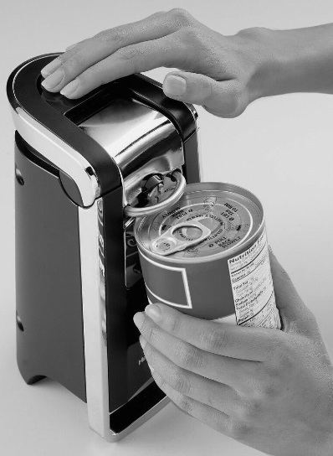
Give your hands a break
Notes:
If writing is painful, try using a thick, rubber grip pen or gel-pen to decrease the amount of pressure used.
Instead of holding open books or magazines with one hand – use a book stand or holder to bring the book to eye level and use a clip to avoid prolonged gripping.
Use pump shampoos and toothpaste and use the palm of your hand to pump instead of squeezing the container.
If possible, get rid of your manual can opener – go electric! Manual can openers can place excessive strain on your joints.

Slide 5
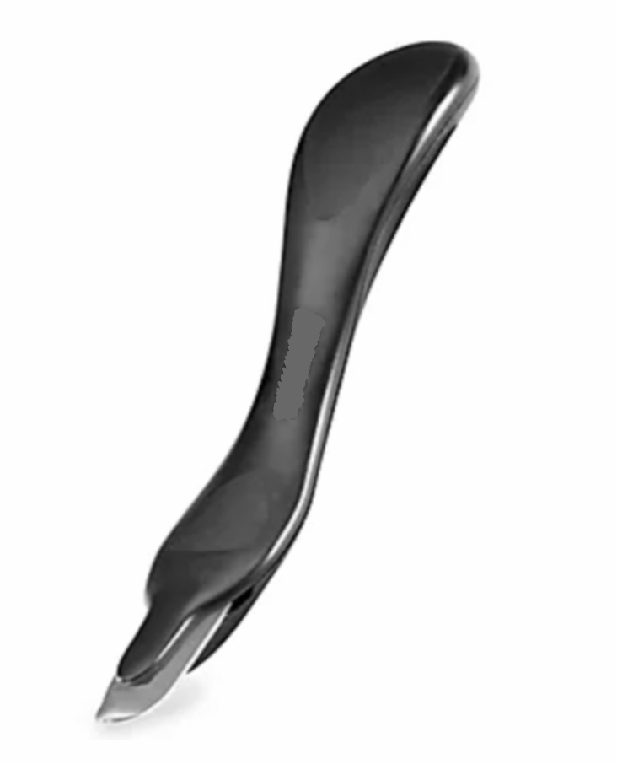
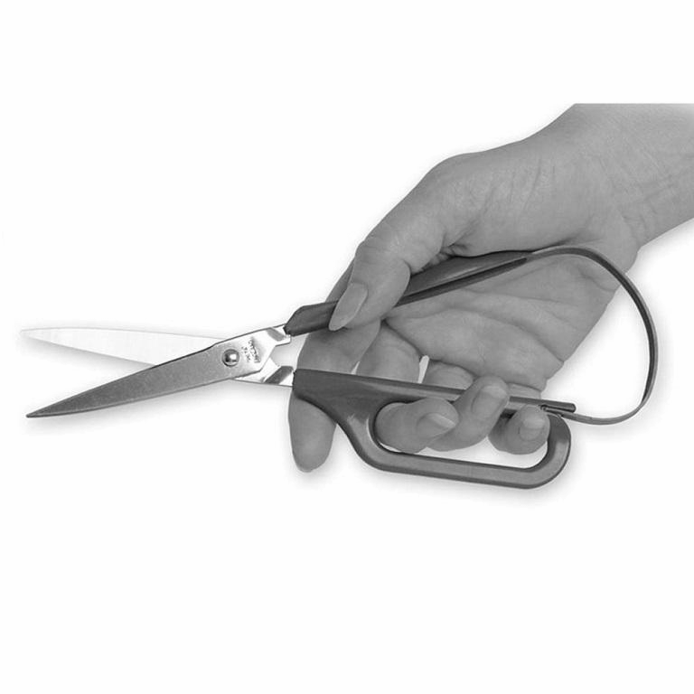
Don’t use your hands as a tool
Always use the right tool for the job – use pliers for tight pinch and a small hammer for pounding.
Don’t tear your mail open – use a letter opener to open the mail.
Use a staple remover instead of your fingers and thumb.
Use utility scissors in the kitchen - do not rip open bags.
Notes:
Scissors with a spring-action design gently open the blades, greatly reducing the effort needed to cut.

Slide 6
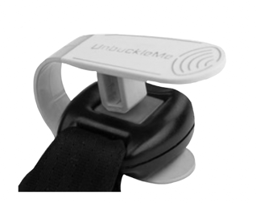
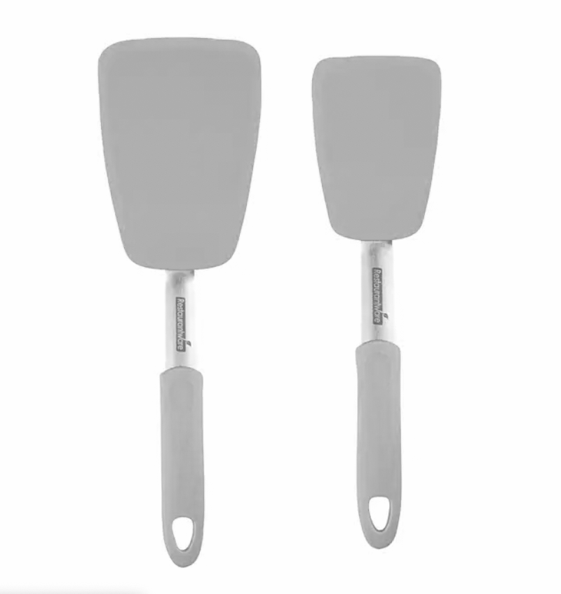
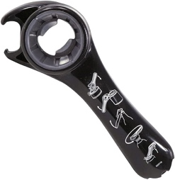
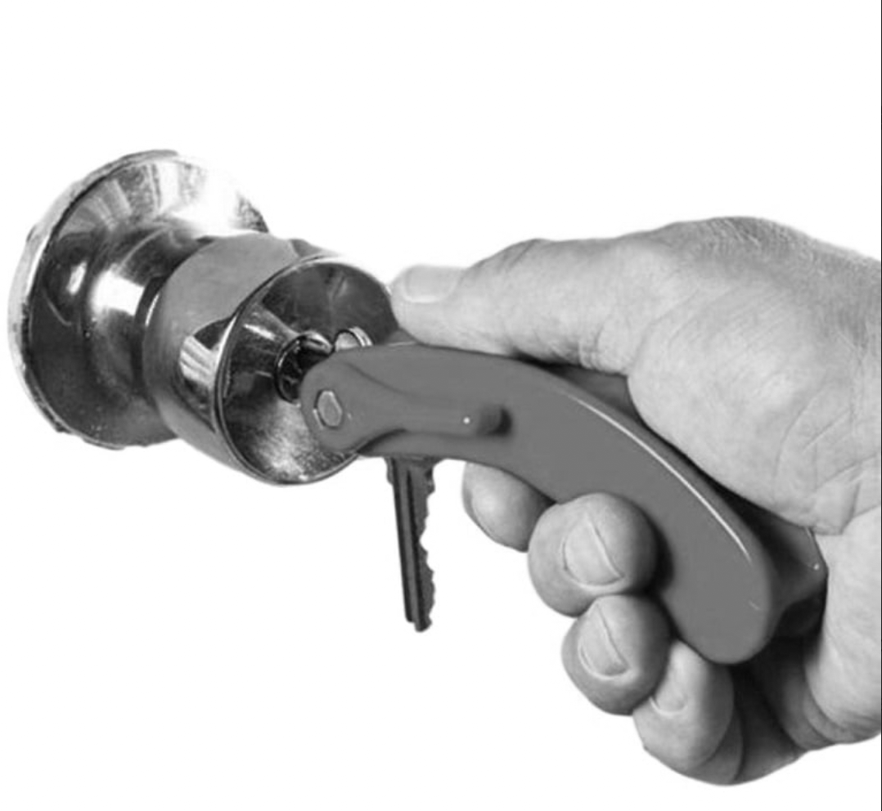
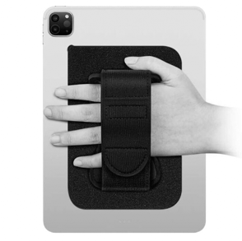
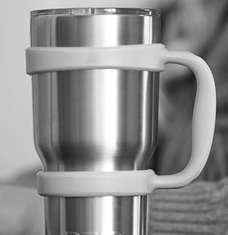
Adaptive equipment
Notes:
Using adaptive equipment is a great way to decrease stress on your joints.
Consider (wrist assured gloves) WAGS gloves to assist in positioning for weight-bearing activities, such as yoga
Consider an “unbuckle me” aid for unfastening car-seat seatbelts
Use a non-slip jar opener as. Purchase lightweight kitchen, gardening and workshop tools with built-up handles
opening jars places undue stress on your joints.
If you have pain when using keys to open doors, consider adding a key extender to your keys
Use devices to hold objects so you don’t have to
Phone pop socket, phone stand, Velcro straps for iPad or tablet, silicone cup handle
I suggest performing a search on the Internet for “adaptive equipment” to see what products are available.

Slide 7
Love your hands!
Your hands work hard for you so treat them with love. No matter what you’re doing, take a second to think about your hands. Your hands will thank you for it.

Slide 8
Contact us…
1210 Gemini Place, Suite 200, Columbus Ohio
614-262-0907
American Society of Hand Therapists
www.asht.org
Notes:
Feel free to contact us with any questions. We are located at 1210 Gemini Place, Suite 200, Columbus Ohio 43240, 740-262-0907, and https://www.thehandcentercolumbus.com/. For more information on hand therapy, please visit the American Society of Hand Therapists, www.asht.org.

